Slide 1
DES

Slide 2
Classification of ciphers
A stream cipher is one that encrypts a digital data stream one bit or one byte at a time.
Ex: Vigenère cipher , Vernam cipher, OTP, RC4
A block cipher is one in which a block of plaintext is treated as a whole and used to produce a ciphertext block of equal length.
EX: AES, DES
A block cipher operates on a plaintext block of n bits to produce a ciphertext block of n bits.
There are 2^n possible different plaintext blocks and, for the encryption to be reversible

Slide 3
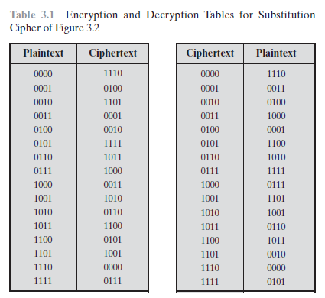
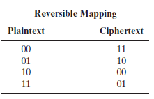

Classification of ciphers
Block cipher

Slide 4
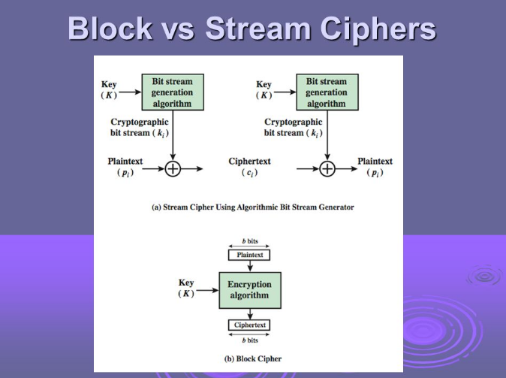
Classification of ciphers

Slide 5
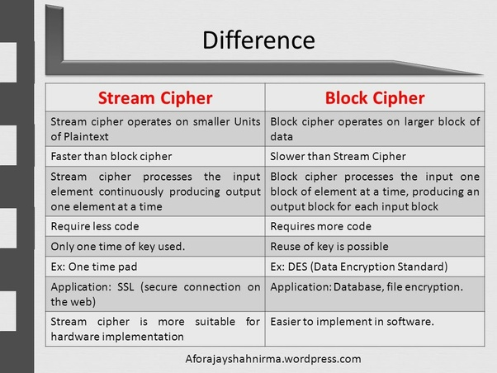

Slide 6
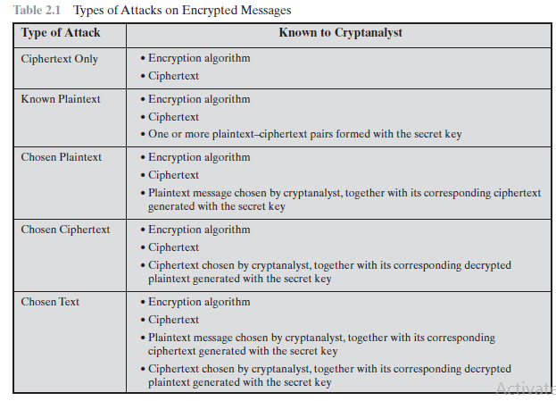

Slide 7
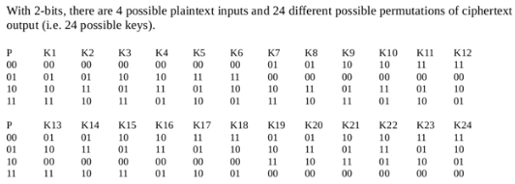
Ideal Block Cipher
Blocks size | Plaintext (No of combinations) | Keys (No. of possible keys) | Key Length (No. of bits to transfer or store)
2 | 2^2 =4 | 4!=24 | Log2 (24)=5 bits
3 | 2^3=8 | 8!=40320 | Log2 (8!)
64 | 2^64=10^19 | 2^64! | Log2 (2^64!)

Slide 8
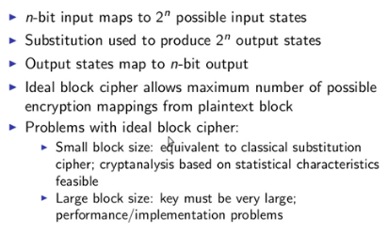
Ideal Block Cipher

Slide 9

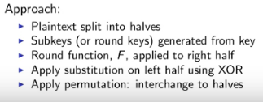
Feistel Structure for Block Cipher

Slide 10
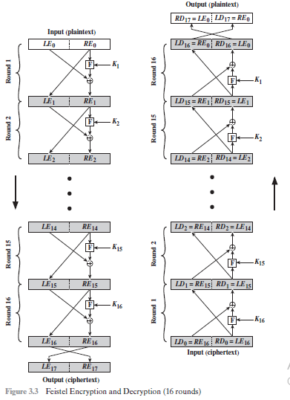
Feistel Structure for Block Cipher

Slide 11
The Feistel Cipher for Block Cipher
Feistel network depends on the choice of the following parameters and design features: (Block cipher design principles)
Block size: Larger block sizes mean greater security but reduced encryption/decryption speed for a given algorithm.
Key size: Larger key size means greater security but may decrease encryption/decryption speed.
Number of rounds: The essence of the Feistel cipher is that a single round offers inadequate security but that multiple rounds offer increasing security.
Subkey generation algorithm: Greater complexity in this algorithm should lead to greater difficulty of cryptanalysis.
Round function F: Again, greater complexity generally means greater resistance to cryptanalysis.

Slide 12
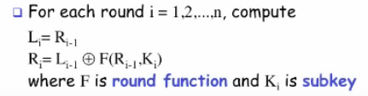
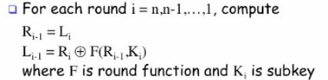
Feistel Structure for Block Cipher

Slide 13



Feistel Structure for Block Cipher
Encryption process
Decryption Process

Slide 14
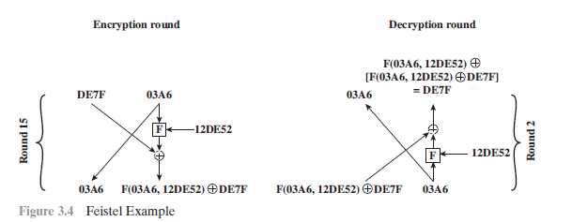
Feistel Structure Example

Slide 15
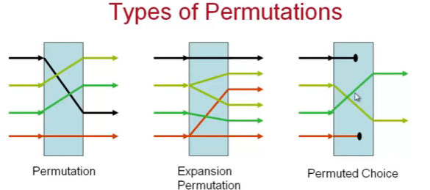
DES (Data Encryption Standard)
Symmetric block cipher
64-bit plaintext, 64-bit ciphertext, 56-bit key (8 bits unused – used for parity check)
Developed by IBM based on LUCIFER algorithm
Complex combination of 2 building blocks: Substitution and Transposition
Easy for brute force attack (because only 56 –bit key is used)

Slide 16
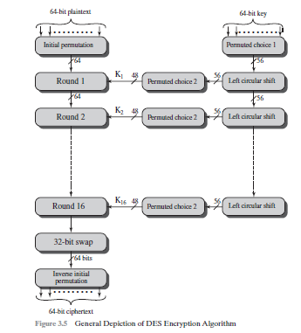
Generic Depiction of DES Encryption Algorithm

Slide 17
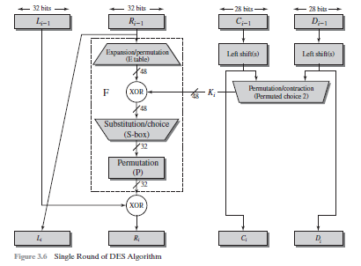
Single Round DES Algorithm

